Slide 1

JC4001: Distributed Systems Federated Learning
Xiaonan Liu
xiaonan.liu@abdn.ac.uk

Slide 2
Outline
What is Federated Learning
A Baseline Algorithm: Federated Averaging
Some Challenges in Federated Learning

Slide 3
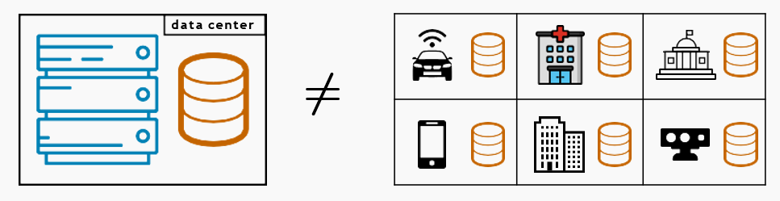
What is Federated Learning
The standard setting in Machine Learning (ML) considers a centralized dataset processed in a tightly integrated system
But in the real world data is often decentralized across many parties

Slide 4
What is Federated Learning
Sending the data may be too costly
Self-driving cars are expected to generate several TBs of data a day
Some wireless devices have limited bandwidth/power
Data may be considered too sensitive
We see a growing public awareness and regulations on data privacy
Keeping control of data can give a competitive advantage in business and research

Slide 5
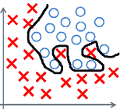
What is Federated Learning
The local dataset may be too small
Sub-par predictive performance (e.g., due to overfitting)
Non-statistically significant results (e.g., medical studies)
The local dataset may be biased
Not representative of the target distribution

Slide 6
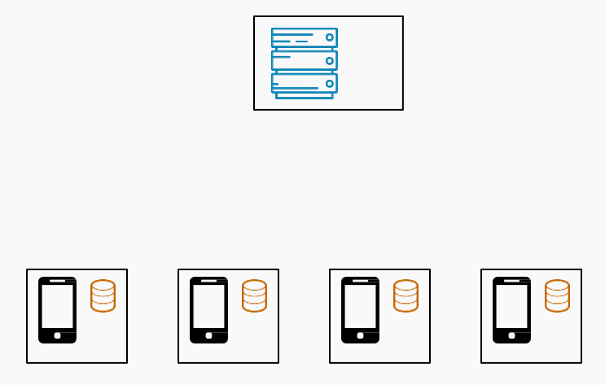
What is Federated Learning
Federated Learning (FL) aims to collaboratively train a ML model while keeping the data decentralized

Slide 7
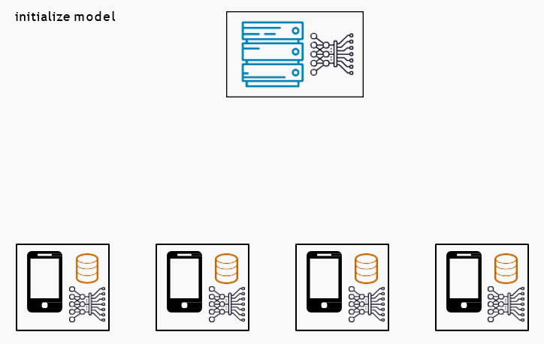
What is Federated Learning
Federated Learning (FL) aims to collaboratively train a ML model while keeping the data decentralized

Slide 8
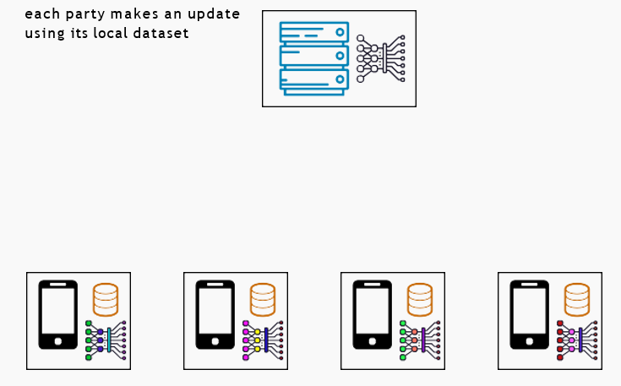
What is Federated Learning
Federated Learning (FL) aims to collaboratively train a ML model while keeping the data decentralized

Slide 9
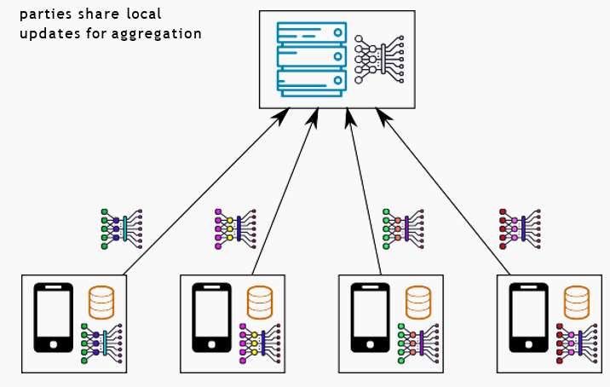
What is Federated Learning
Federated Learning (FL) aims to collaboratively train a ML model while keeping the data decentralized

Slide 10
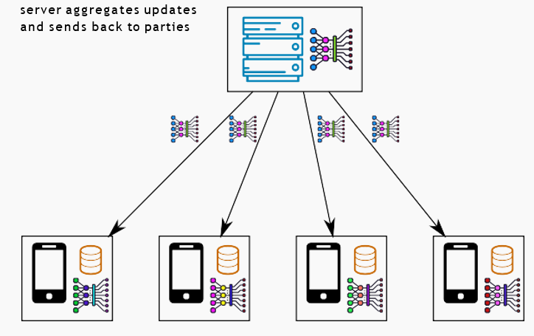
What is Federated Learning
Federated Learning (FL) aims to collaboratively train a ML model while keeping the data decentralized

Slide 11
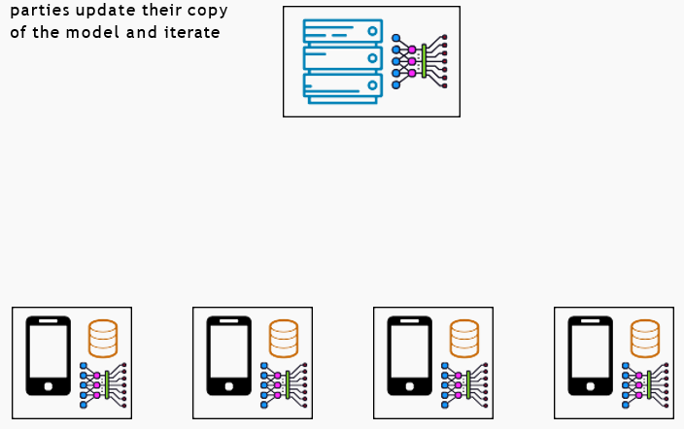
What is Federated Learning
Federated Learning (FL) aims to collaboratively train a ML model while keeping the data decentralized
We would like the final model to be as good as the centralized solution (ideally), or at least better than what each party can learn on its own

Slide 12
Differences with Distributed Learning
In distributed learning, data is centrally stored (e.g., in a data center)
The main goal is just to train faster
We control how data is distributed across workers: usually, it is distributed uniformly at random across workers
In FL, data is naturally distributed and generated locally
Data is not independent and identically distributed (non-i.i.d.), and it is imbalanced
Additional challenges that arise in FL
Enforcing privacy constraints
Dealing with the possibly limited reliability/availability of participants
Achieving robustness against malicious parties

Slide 13
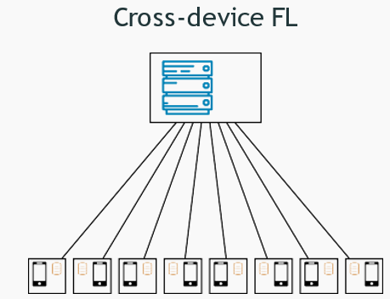
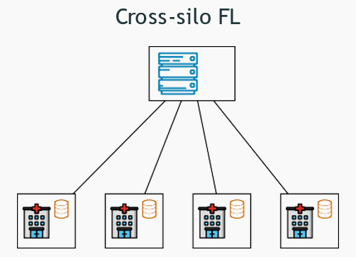
Cross-Device and Cross-Silo FL
Massive number of parties (up to 10^10)
Small dataset per party (could be size 1)
Limited availability and reliability
Some parties may be malicious
2-100 parties
Medium to large dataset per party
Reliable parties, almost always available
Parties are typically honest

Slide 14
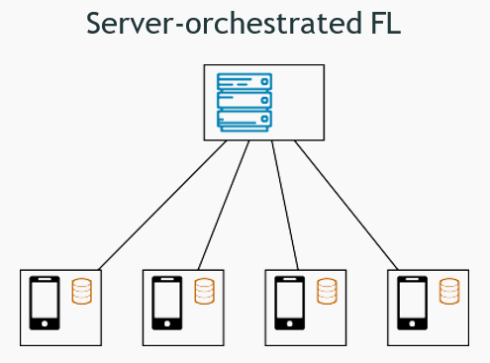
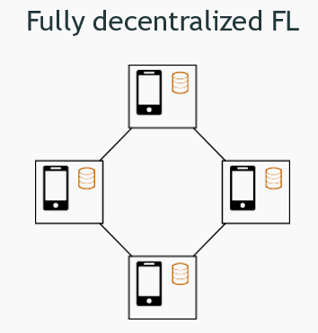
Server Orchestrated and Fully Distributed FL
Server-client communication
Global coordination, global aggregation
Server is a single point of failure and may become a bottleneck
Device-to-device communication
No global coordination, local aggregation
Naturally scales to a large number of devices

Slide 15
FL is a Booming Topic
2016: the term FL is first coined by Google researchers; 2020: more than 1,000 papers on FL in the first half of the year
We have already seen some real-world deployments by companies and researchers
Several open-source libraries are under development: PySyft, TensorFlow Federated, FATE, Flower, Substra...
FL is highly multidisciplinary: it involves machine learning, numerical optimization, privacy & security, networks, systems, hardware...

Slide 16

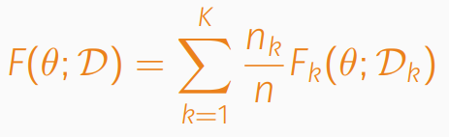
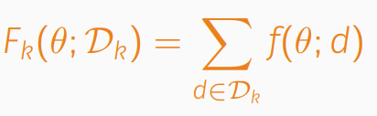
A Baseline Algorithm: Federated Averaging
We consider a set of K parties (clients)
Each party k holds a dataset Dk of nk points
Let D = D1 ∪ · · · ∪ DK be the joint dataset and n = Σk nk the total number of points
We want to solve problems of the form minθ∈Rp F(θ; D) where:
θ ∈ Rp are model parameters (e.g., weights of a logistic regression or neural network)
This covers a broad class of ML problems formulated as empirical risk minimization

Slide 17
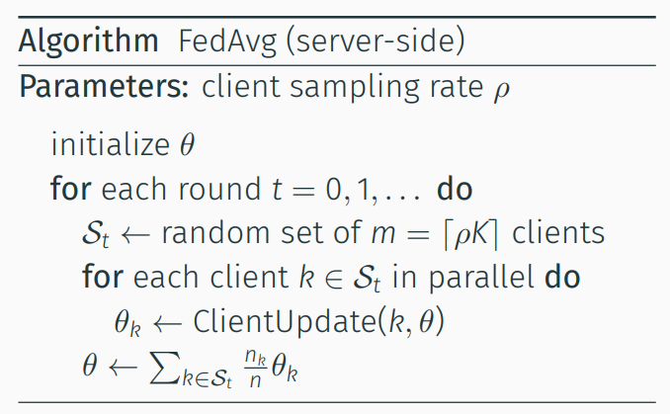
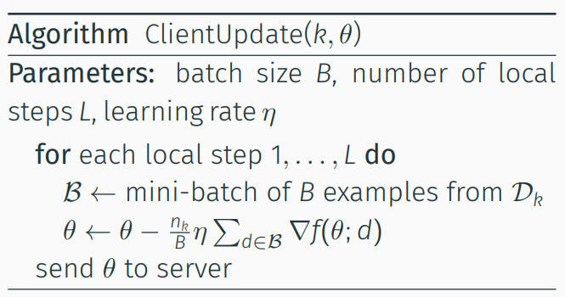
FedAvg
For L = 1 and ρ = 1, it is equivalent to classic parallel SGD: updates are aggregated and the model synchronized at each step
For L > 1: each client performs multiple local SGD steps before communicating

Slide 18

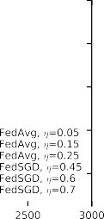

FedAvg
FedAvg with L > 1 allows to reduce the number of communication rounds, which is often the bottleneck in FL (especially in the cross-device setting)
It empirically achieves better generalization than parallel SGD with large mini-batch
Convergence to the optimal model can be guaranteed for i.i.d. data [Stich, 2019] [Woodworth et al., 2020] but issues arise in strongly non-i.i.d. case (more on this later)

Slide 19
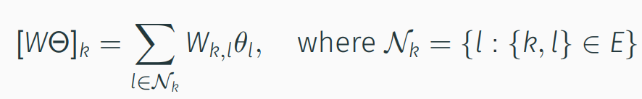
Fully Decentralized Learning
We can derive algorithms similar to FedAvg for the fully decentralized setting, where parties do not rely on a server for aggregating updates
Let G = ({1, . . . , K}, E) be a connected undirected graph where nodes are parties and an edge {k, l} ∈ E indicates that k and l can exchange messages
Let W ∈ [0, 1]K×K be a symmetric, doubly stochastic matrix such that Wk,l = 0 if and only if {k, l} ∈/ E
Given models Θ = [θ1, . . . , θK] for each party, WΘ corresponds to a weighted aggregation among neighboring nodes in G:

Slide 20
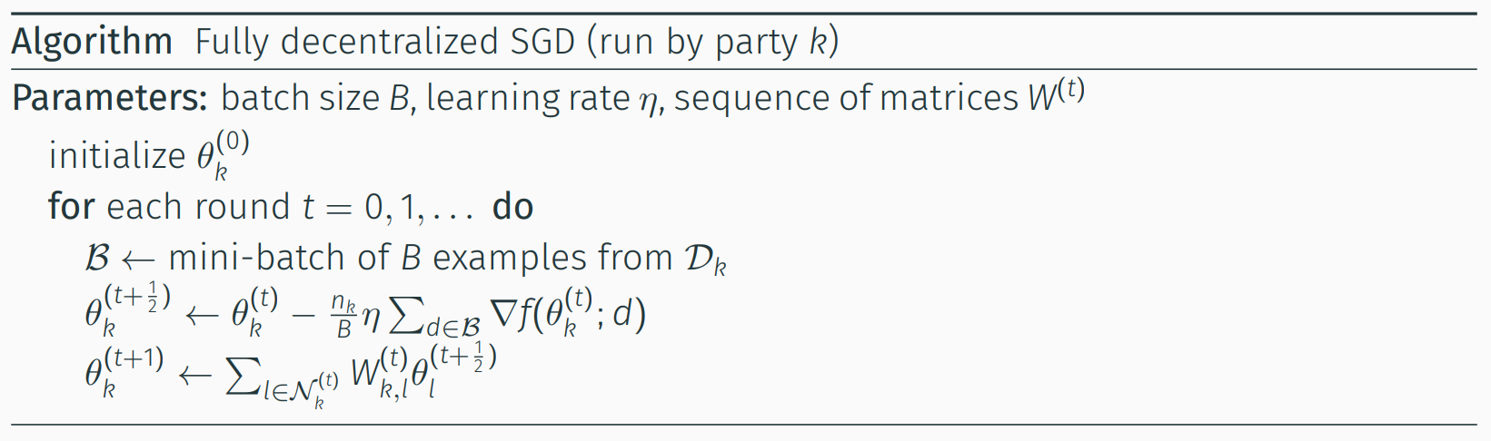
Fully Decentralized SGD
Decentralized SGD alternates between local updates and local aggregation
Doing multiple local steps is equivalent to choosing W(t) = In in some of the rounds
The convergence rate depends on the topology (the more connected, the faster)

Slide 21
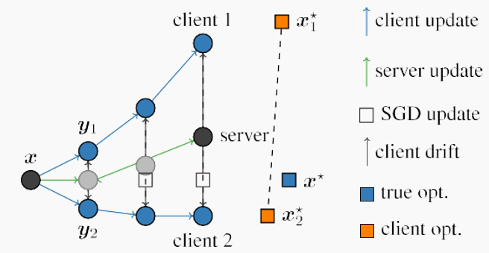
Some Challenges in FL
When local datasets are non-i.i.d., FedAvg suffers from client drift
To avoid this drift, one must use fewer local updates and/or smaller learning rates, which hurts convergence

Slide 22
FL of Personalized Models
Learning from non-i.i.d. data is difficult/slow because each party wants the model to go in a particular direction
If data distributions are very different, learning a single model which performs well for all parties may require a very large number of parameters
Another direction to deal with non-i.i.d. data is thus to lift the requirement that the learned model should be the same for all parties (“one size fits all”)
Instead, we can allow each party k to learn a (potentially simpler) personalized model θk but design the objective so as to enforce some kind of collaboration

Slide 23

Thank You

